Slide 1

AI IN FUTURE WARFARE
Presentation for my Review Paper

Slide 2
TABLE OF CONTENTS
01
04
02
05
03
06
INTRODUCTION
MY ANALYSIS ON DATASET
Methodology
FINDINGS
AUTHORS’ ANALYSIS
CONCLUSION

Slide 3
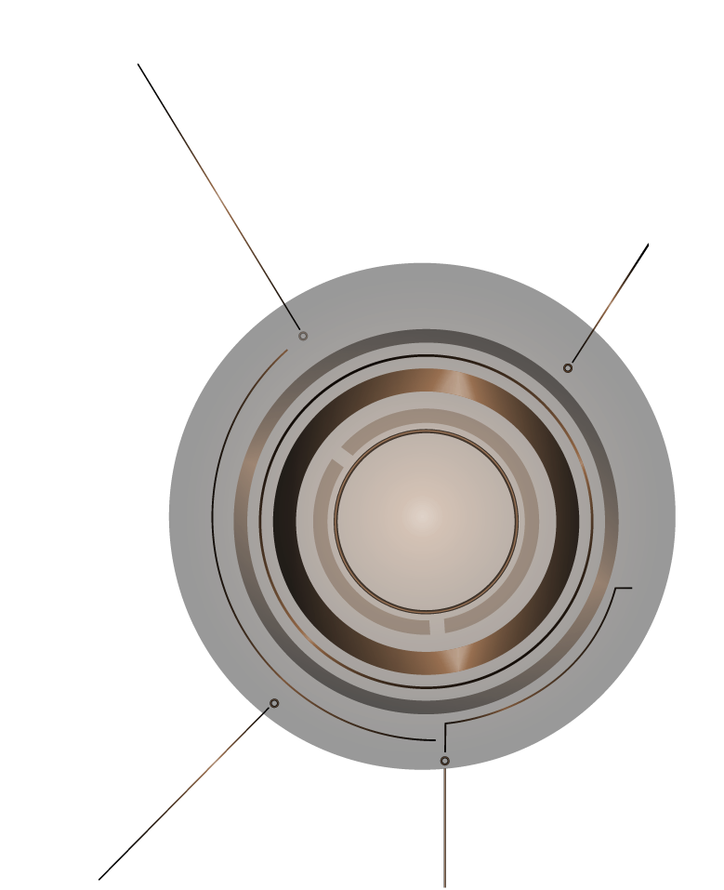
INTRODUCTION
Two research papers have been read for knowing the current trends of AI in military.
The first paper was written by Miss L.Cummings named‘AI and The Future of Warfare’
The second paper was written by Lingjuan Li named ‘AI and the Future of War: The Impact of Machine Learning in Security Practice’.
AI IN
WAR

Slide 4
INTRODUCTION
The first paper discusses about autonomous drones in the military.
What are the hurdles in making autonomous drones for the war.
Miss cummings gave two strong reason that why autonomous drones are not made as much as in the commercial market. She said the commercial market is growing strong than military in making autonomous things. That can lead to shift of power from military to big tech companies who are making great in commercial market.
AI IN
WAR

Slide 5
INTRODUCTION
She further argues the cost of autonomous drones in the military.
For example, F-22 and X-47 aircraft, both were aimed to have the autonomous but they both faced technical issues and consumed much higher budget: the cost of F-22 for one hour operation is $68362 however the same job can be done by the Predator aircraft with cost $3679 and it does not have any technical issue.
AI IN
WAR

Slide 6
INTRODUCTION
The second paper discusses about the AI and ML based algorithms in the military bases where no autonomous drones are envolved to target its enemy etc.
AI IN
WAR

Slide 7

Methodology

Slide 8
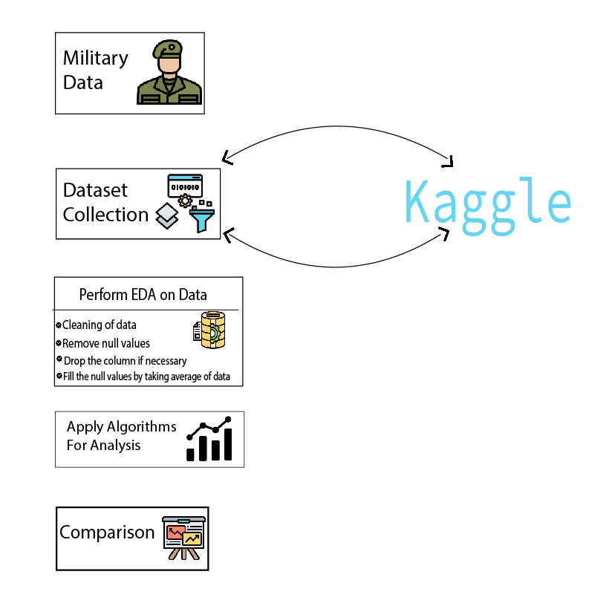
For knowing the involvement of autonomous drones on military, the military dataset was taken
Then analysis was perfomed on that data.
For knowing the rise in autonomous agents/drones in military and commercial market.

Slide 9

Author’s Analysis

Slide 10
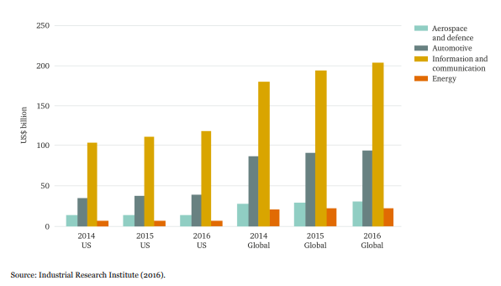
Miss Cummings gives the graph that indicates how fast commercial market is growing than the military. And how many billions of dollars are invested in this market.

Slide 11
Here clearly can be seen how the commercial is growing.
The yellow pillar shows commercial market that is reaching upto $200 billion dollars.
Whereas the other two are very very less as compared to this which shows the military interest.

Slide 12

MY ANALYSIS ON DATASET

Slide 13
The analysis was performed on the military dataset that was taken from kaggle.
The graphs and charts are obtained by applying various algorithms.
I am showing those graps below.

Slide 14
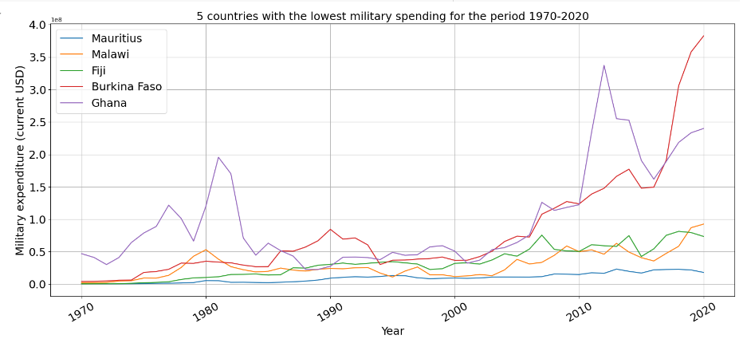
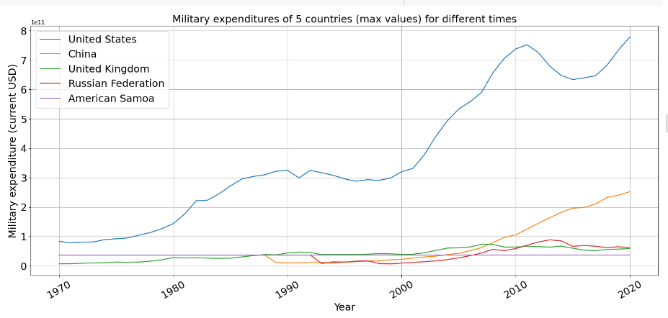

Slide 15
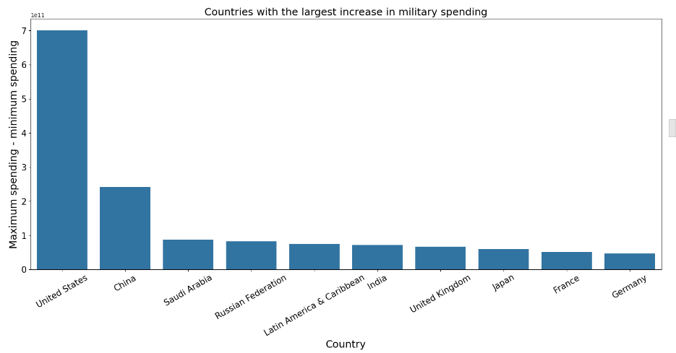

Slide 16

FINDINGS

Slide 17
You have seen author’s analysis and my analysis. Both are confirming the less spending of military in making autonomous drones whereas commercial market is touching the figure $200 billion dollars.
But military’s figure goes upto $8 billion dollars.
By seeing facts and figures, it has been cleared that military is not taking an interest in making autonomous drones. Reasons have been discussed above.
On the other hand, the commercial market is rising day by day.

Slide 18
Thanks!
DO YOU HAVE ANY QUESTIONS?
My E-mail: Umair03042204122@gmail.com
My Twitter: @Mrmondaybs
Phone: 03042204122

